Slide 1
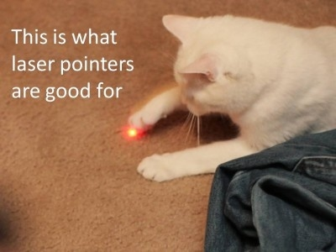

Laser Assisted Ink Picker
Let your cat get your ink
Team Members
Renate Pyhel
Amitav Khandelwal
Evan Lecompete
Amit Navare
Emma Pu
Umer Younas

Slide 2
Laser Assisted Ink Picker
Let your cat get your ink
Hard Job
Waste of Time
Needs Assistance
Too High can’t even see

Slide 3

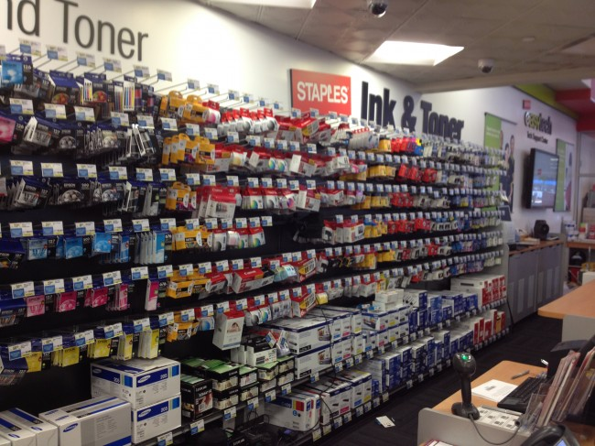
GOOD LUCK Finding Your INK !

Slide 4
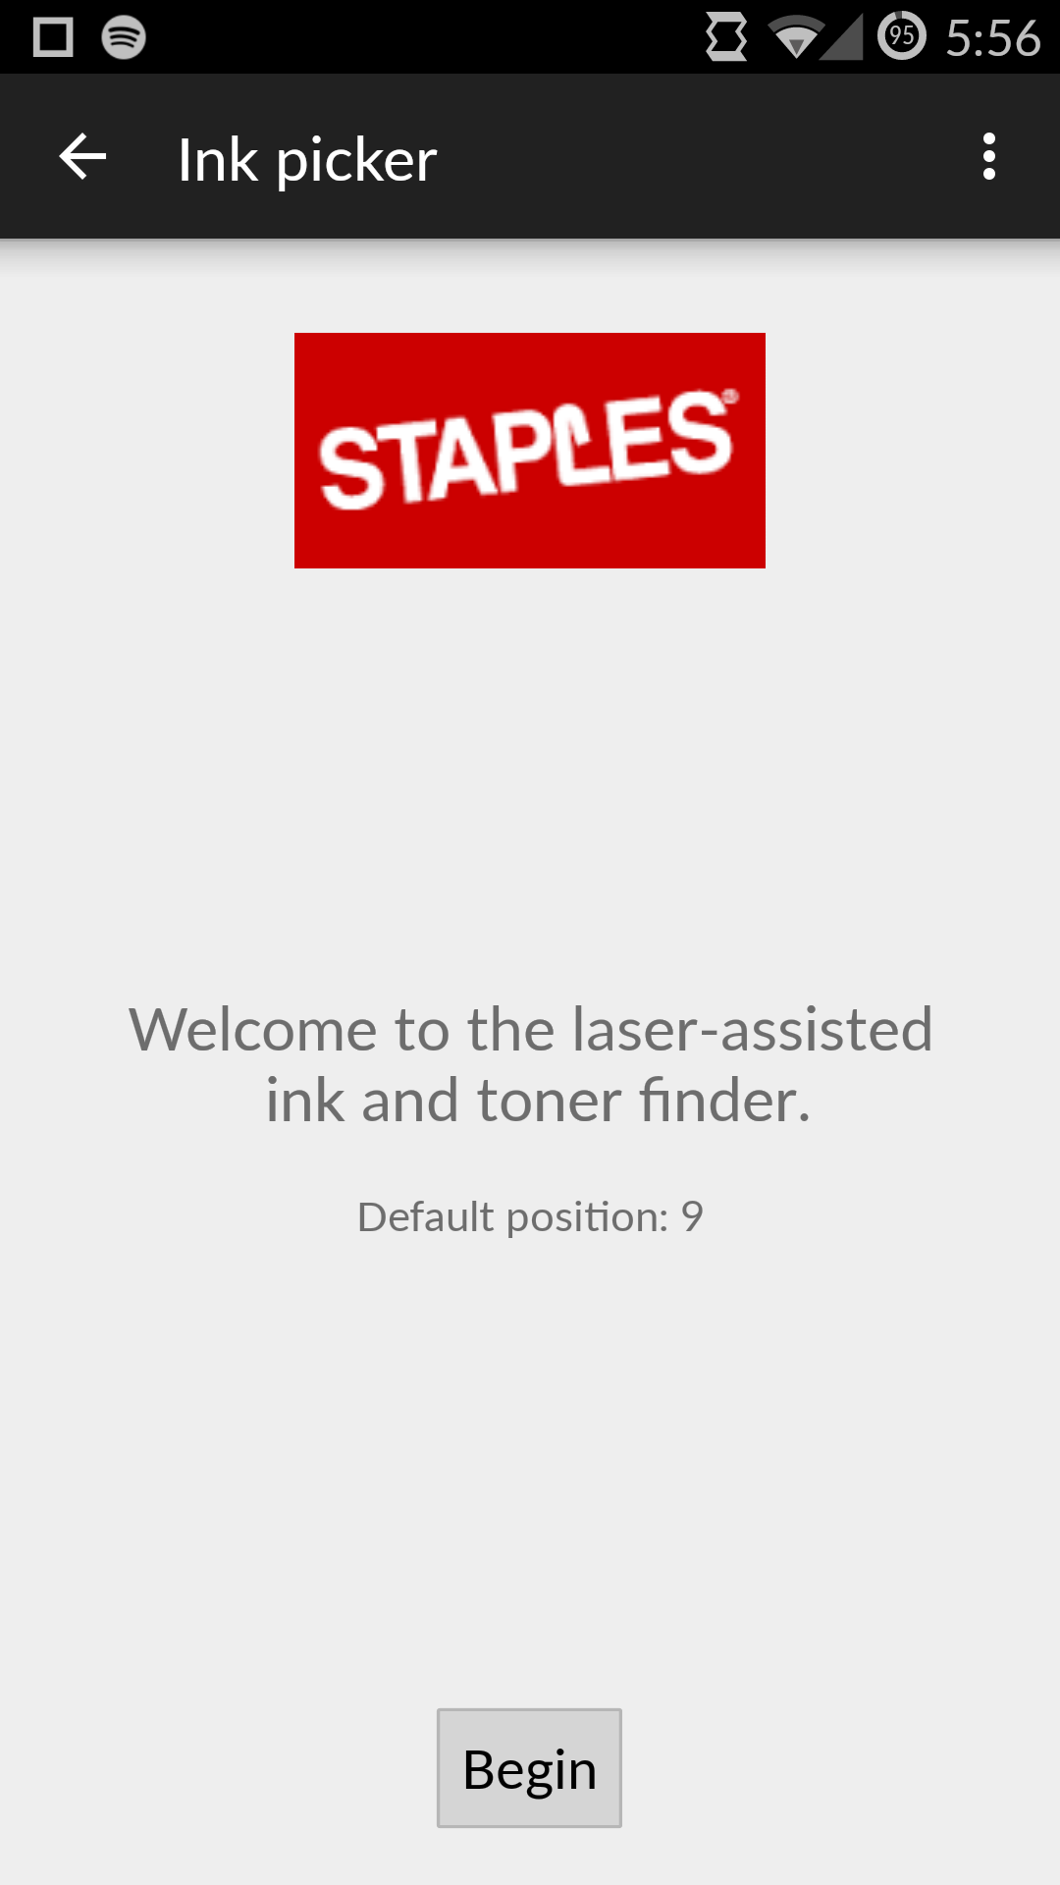
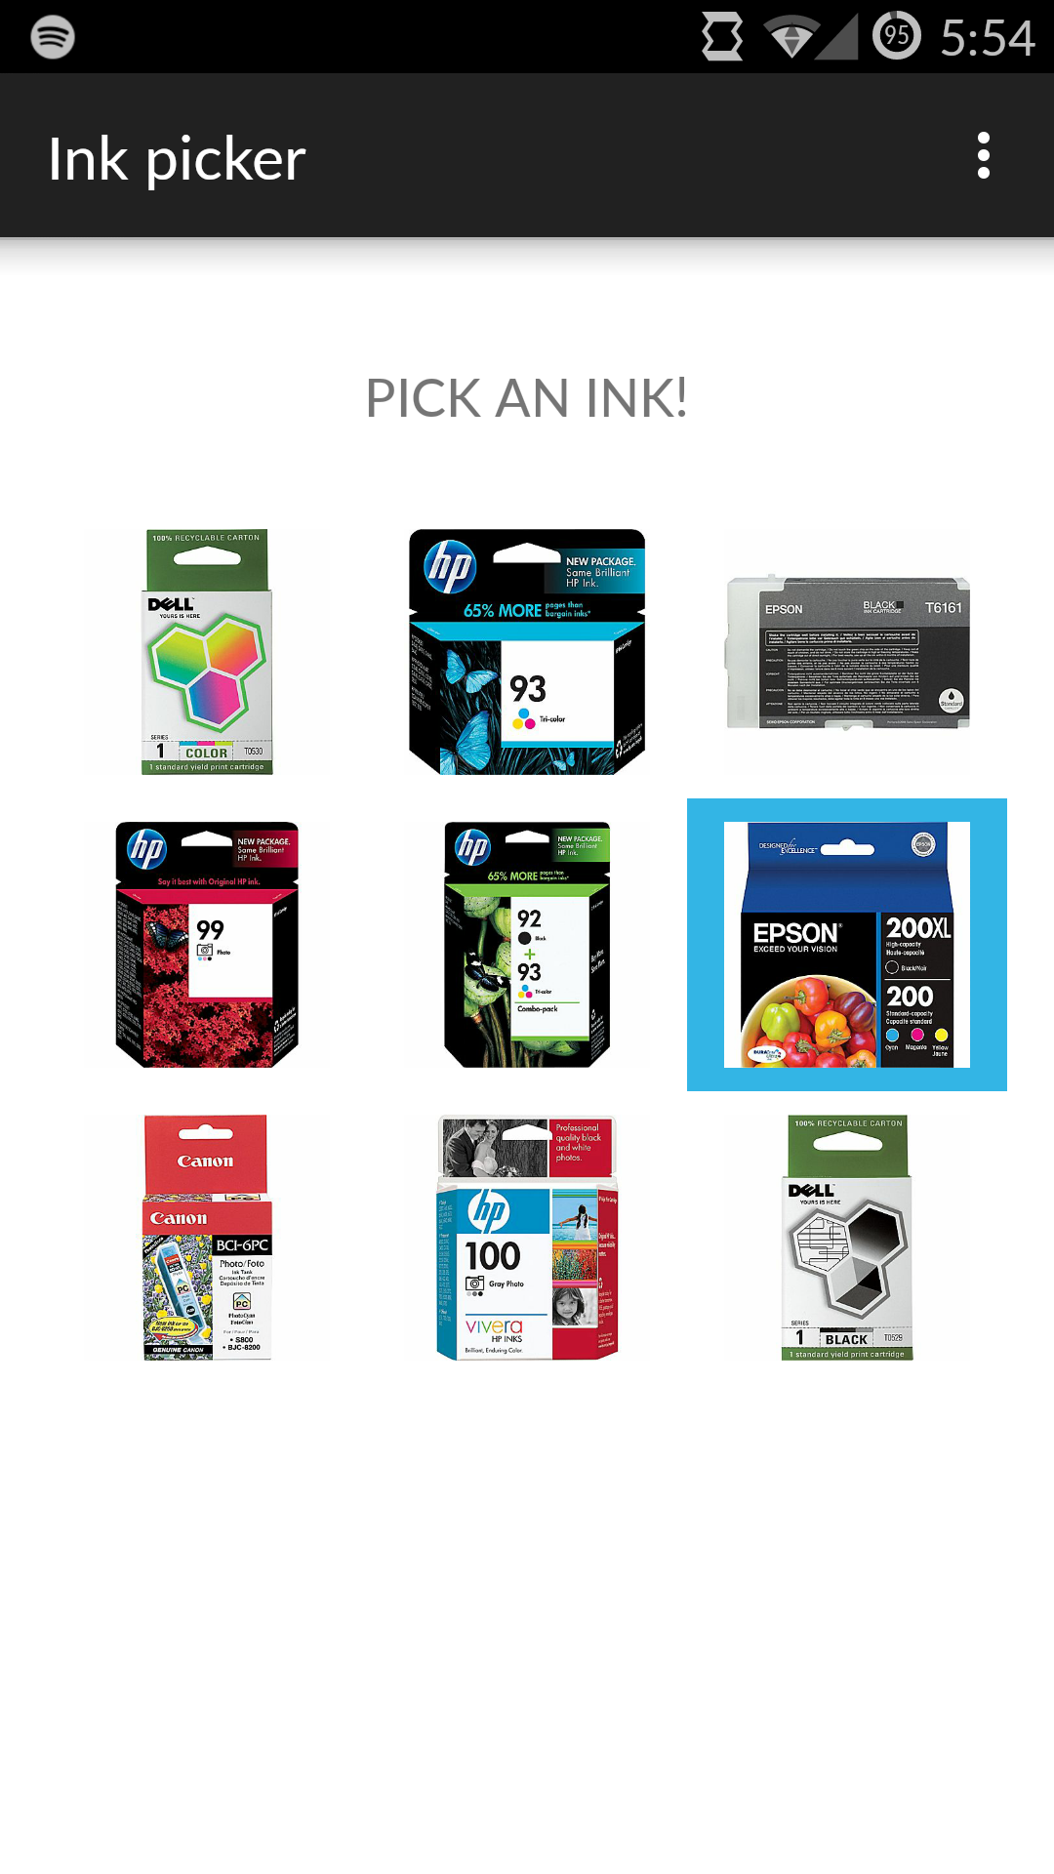
Mobile

Slide 5
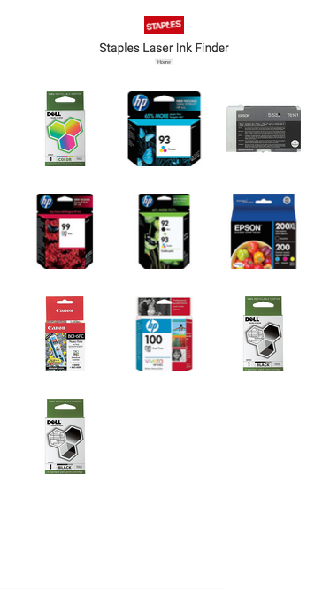
Web

Slide 6
Thank You
Let’s go to Demo

